Slide 1
HDLC and PPP

Slide 2
11-6 HDLC
Bit-oriented protocol for communication
over point-to-point and multipoint links.
Implements the ARQ mechanisms
Operates in 2 modes:
Normal Response Mode
1 primary and multiple secondary
Point to point as well as point to multi point
Primary Sends, Secondary respond
Asynchronous Balanced Mode
Balanced Configuration
Each station can behave as both primary and secondary, i.e., peers

Slide 3
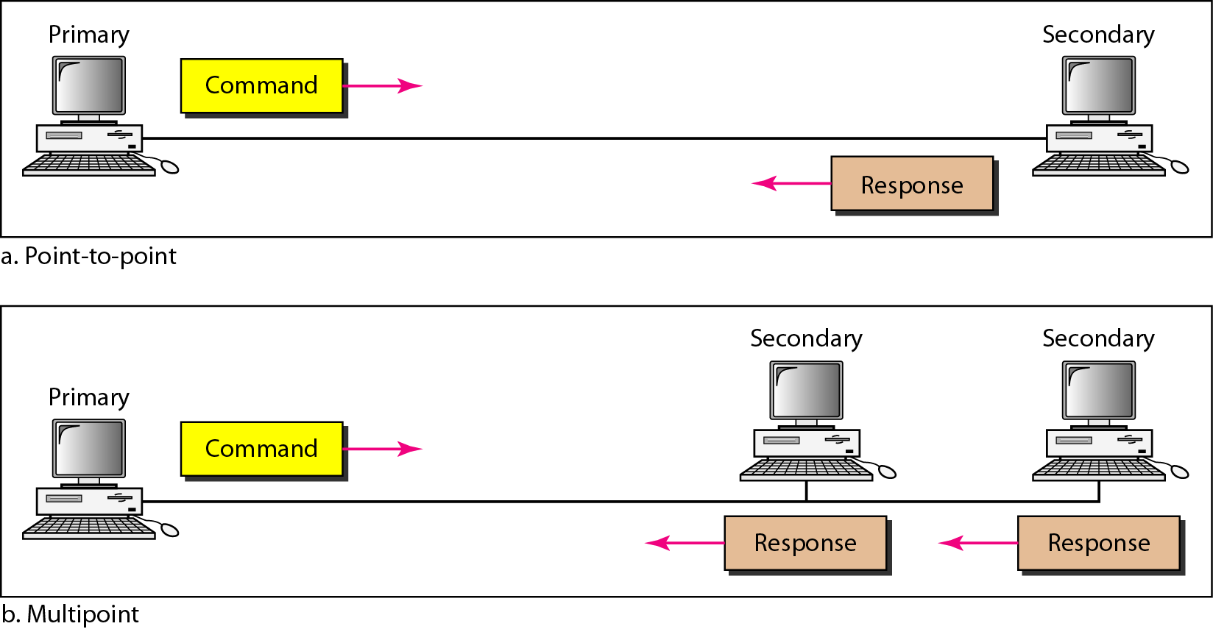
Figure 11.25 Normal response mode

Slide 4
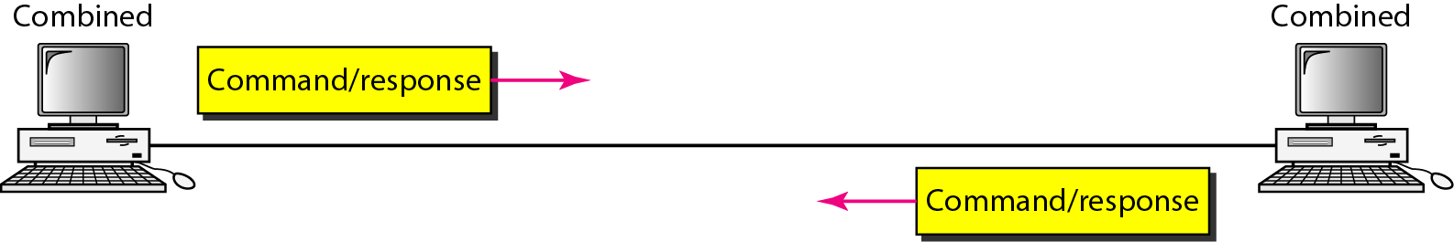
Figure 11.26 Asynchronous balanced mode

Slide 5
HDLC Frames
Each frame serves as envelope for transmission of different types of messages.
I-Frame
Transport user data and control information relating to user data (piggybacking)
S-Frame
Transport control information
U-Frame
Reserved for system management
Manages the link itself

Slide 6
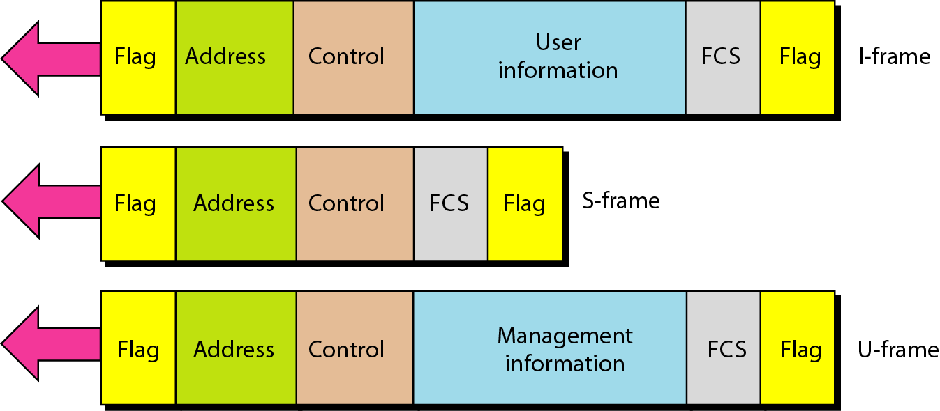
8-bit sequence 01111110 identifies beginning and end of a frame and serves as synchronization pattern
Error Detection Field.
Figure 11.27 HDLC frames
If Primary created frame, this field contains receiver’s address.
If created by Secondary, it contains sender’s address.
Can be 1 to several bytes long.
If one byte, 7-bits are used for 128 addresses last bit denotes size of the address.
If 1 byte, last bit is 1.
If more than 1 byte, all bytes except the last byte will have the bit as 0.
Last byte will have the bit as 1.

Slide 7
Control Field
Determines the type of frame and defines its functionality
I-Frames:
Designed to carry user data from network layer
Include flow and error control info (piggybacking)

Slide 8
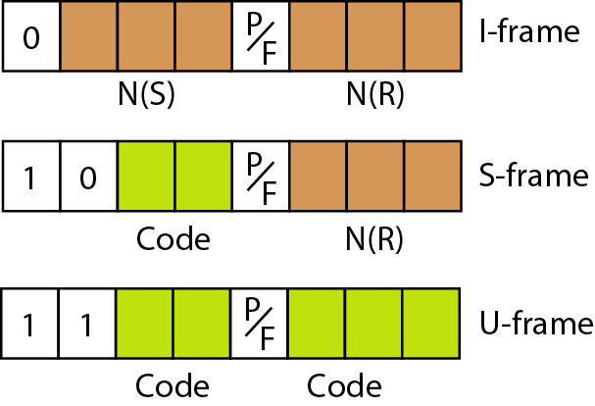
Figure 11.28 Control field format for the different frame types
Define sequence no. of the frame
ACK No. when piggybacking is used
Defines the Type of Frame
Has meaning only if value is 1. Means poll when sent from P to S. Means final when sent from S to P

Slide 9
Control Field
Determines the type of frame and defines its functionality
I-Frames:
Designed to carry user data from network layer
Include flow and error control info (piggybacking)
S-Frames:
Supervisory frames. Control flow and error when piggybacking not possible

Slide 10
Figure 11.28 Control field format for the different frame types
Define the type of the frame
ACK No. when piggybacking is used
Defines the Type of Frame
Code | Frame
00 | Receive Ready(RR). Acknowledges receipt of error-free frame
10 | Receive Not Ready (RNR). Acknowledges receipt of error-free frame and also says receiver is busy and cannot accept any more frame
01 | Reject (REJ) NAK like go back N ARQ
11 | Selective Reject(SREJ). NAK of selective repeat ARQ.

Slide 11
Control Field
Determines the type of frame and defines its functionality
I-Frames:
Designed to carry user data from network layer
Include flow and error control info (piggybacking)
S-Frames:
Supervisory frames. Control flow and error when piggybacking not possible
U-Frames:
Unnumbered frames. Codes in 2 parts-prefix and suffix. Together 5 bits i.e. 32 combinations

Slide 12
Figure 11.28 Control field format for the different frame types
Defines the Type of Frame
Suffix
Prefix

Slide 13
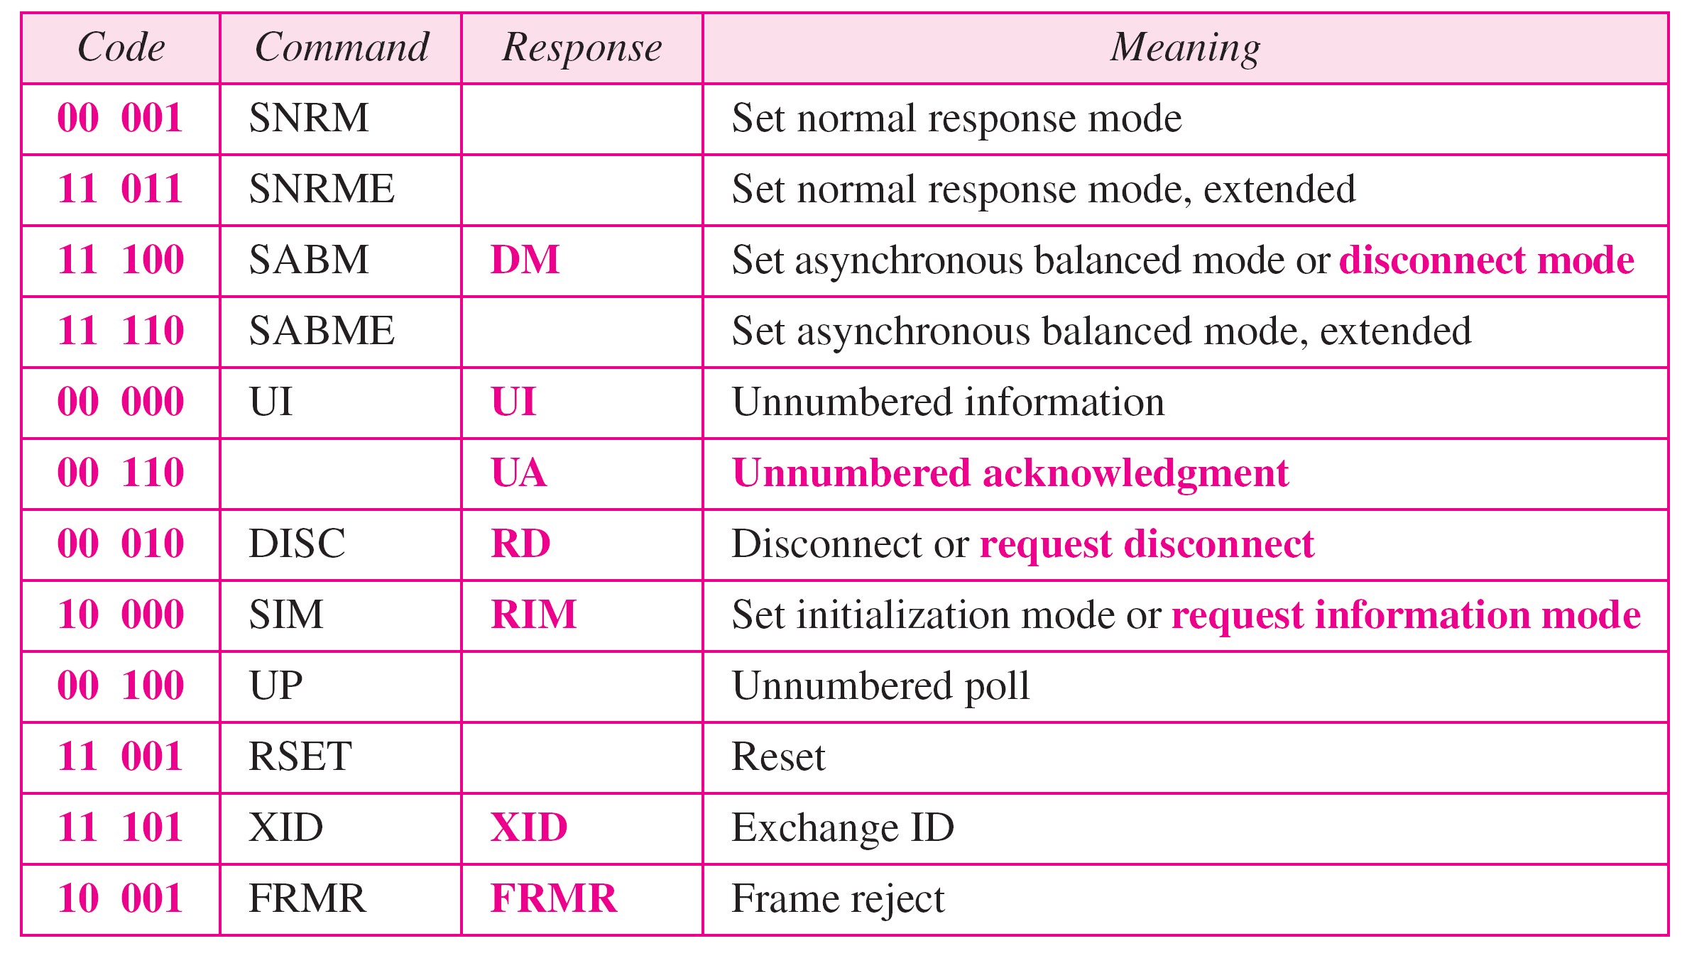
Table 11.1 U-frame control command and response

Slide 14
Example 11.9
Figure 11.29 shows how U-frames can be used for connection establishment and connection release. Node A asks for a connection with a set asynchronous balanced mode (SABM) frame; node B gives a positive response with an unnumbered acknowledgment (UA) frame. After these two exchanges, data can be transferred between the two nodes (not shown in the figure). After data transfer, node A sends a DISC (disconnect) frame to release the connection; it is confirmed by node B responding with a UA (unnumbered acknowledgment).

Slide 15
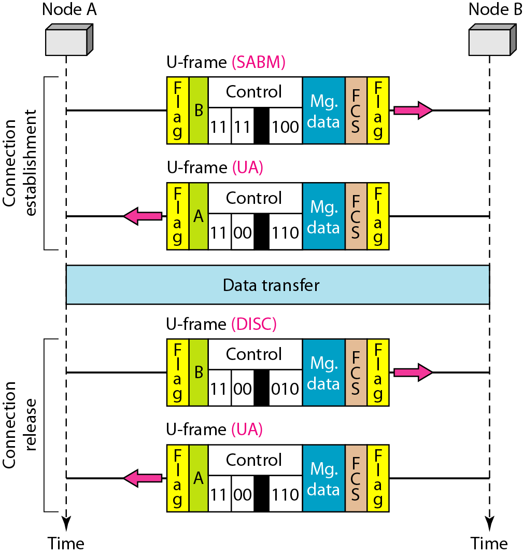
Figure 11.29 Example of connection and disconnection

Slide 16
Example 11.10
Figure 11.30 shows an exchange using piggybacking. Node A begins the exchange of information with an I-frame numbered 0 followed by another I-frame numbered 1. Node B piggybacks its acknowledgment of both frames onto an I-frame of its own. Node B’s first I-frame is also numbered 0 [N(S) field] and contains a 2 in its N(R) field, acknowledging the receipt of A’s frames 1 and 0 and indicating that it expects frame 2 to arrive next. Node B transmits its second and third I-frames (numbered 1 and 2) before accepting further frames from node A.

Slide 17
Example 11.10 (continued)
Its N(R) information, therefore, has not changed: B frames 1 and 2 indicate that node B is still expecting A’s frame 2 to arrive next. Node A has sent all its data. Therefore, it cannot piggyback an acknowledgment onto an I-frame and sends an S-frame instead. The RR code indicates that A is still ready to receive. The number 3 in the N(R) field tells B that frames 0, 1, and 2 have all been accepted and that A is now expecting frame number 3.

Slide 18
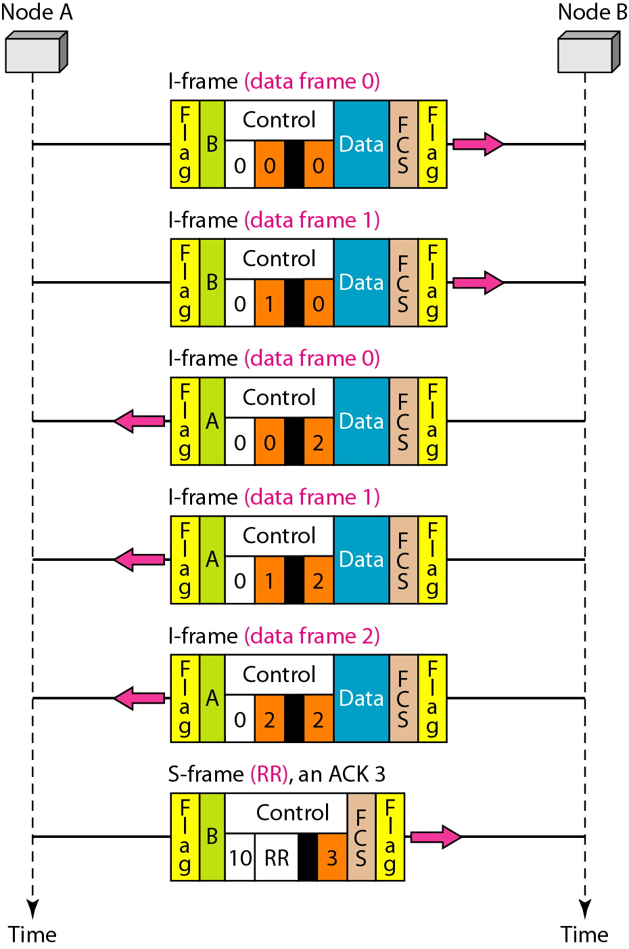
Figure 11.30 Example of piggybacking without error

Slide 19
Example 11.11
Figure 11.31 shows an exchange in which a frame is lost. Node B sends three data frames (0, 1, and 2), but frame 1 is lost. When node A receives frame 2, it discards it and sends a REJ frame for frame 1. Note that the protocol being used is Go-Back-N with the special use of an REJ frame as a NAK frame. The NAK frame does two things here: It confirms the receipt of frame 0 and declares that frame 1 and any following frames must be resent. Node B, after receiving the REJ frame, resends frames 1 and 2. Node A acknowledges the receipt by sending an RR frame (ACK) with acknowledgment number 3.

Slide 20
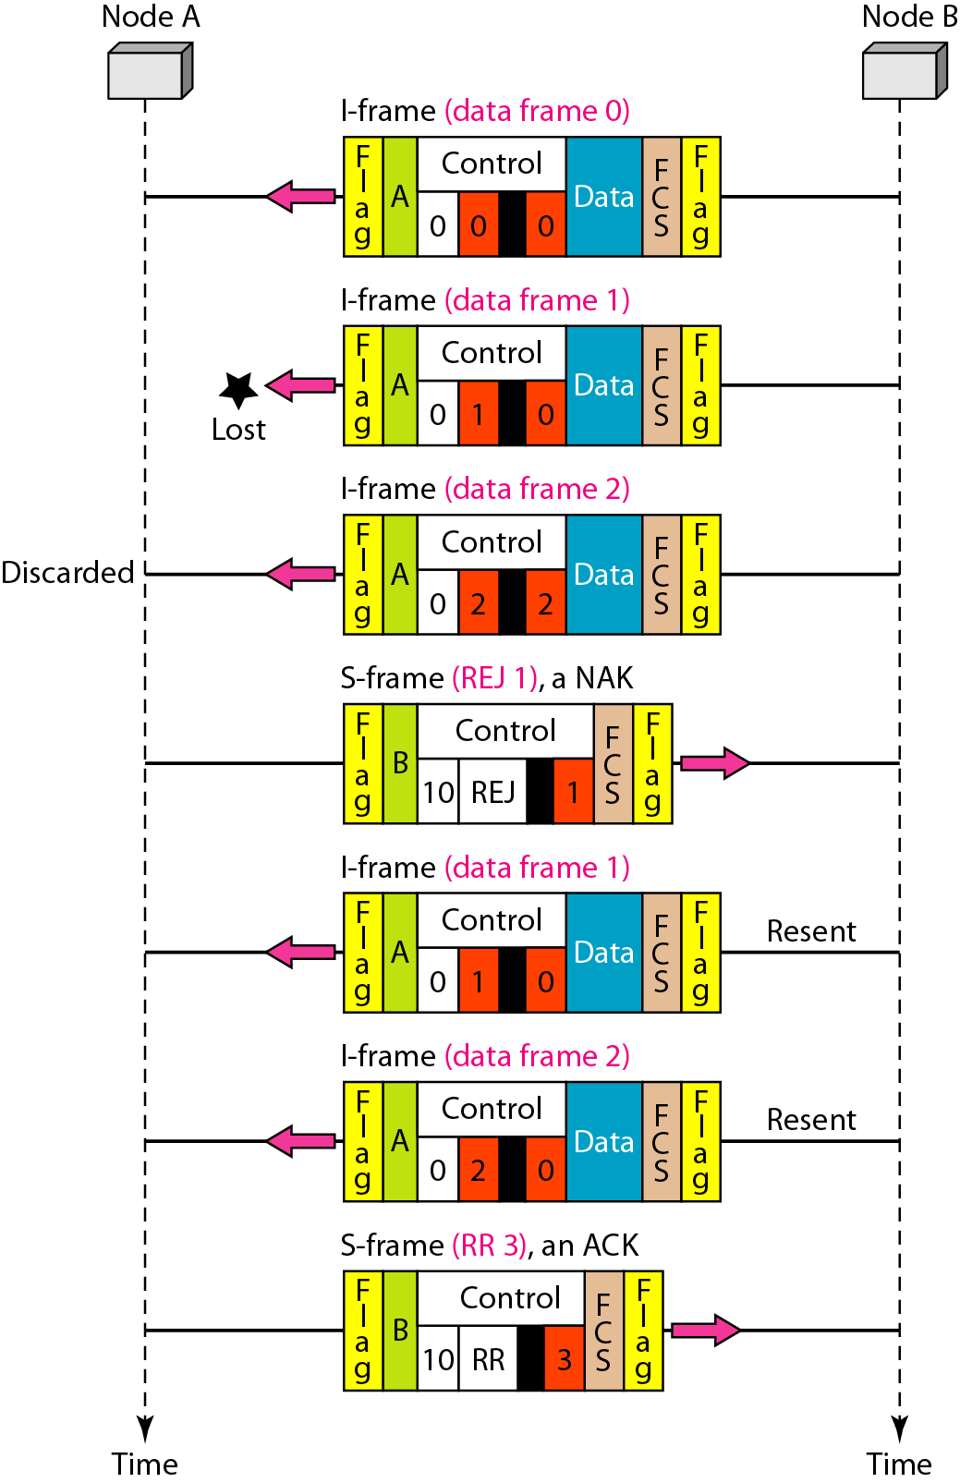
Figure 11.31 Example of piggybacking with error

Slide 21
11-7 POINT-TO-POINT PROTOCOL
Although HDLC is a general protocol that can be used for both point-to-point and multipoint configurations, one of the most common protocols for point-to-point access is the Point-to-Point Protocol (PPP).
PPP is a byte-oriented protocol with escape sequence 01111101.
Most commonly used protocol for data link layer to data link layer communication

Slide 22
PPP Services
PPP defines the frame format to be exchanged between devices.
PPP defines negotiation due to the link establishment and data exchange.
PPP defines encapsulation of network layer data in the data link frame.
PPP defines authentication of two devices to one another
PPP provides multiple network layer services supporting a variety of network layer protocols.
PPP provides connections over multiple links.
PPP provides network address configuration. This is particularly useful when a home user needs a temporary network address to connect to the Internet.

Slide 23
PPP Services
On the other hand, to keep PPP simple, several services are missing:
PPP does not provide flow control.
A sender can send several frames one after another with no concern about overwhelming the receiver.
PPP has a very simple mechanism for error control.
A CRC field is used to detect errors. If the frame is corrupted, it is silently discarded; the upper-layer protocol needs to take care of the problem. Lack of error control and sequence numbering may cause a packet to be received out of order.
PPP does not provide a sophisticated addressing mechanism to handle frames in a multipoint configuration.

Slide 24
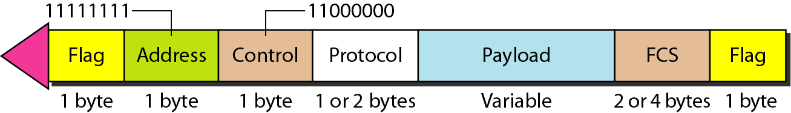
Figure 11.32 PPP frame format
Imitates unnumbered frames in HDLC. Field is optional as negligible flow and error control in PPP
May be omitted based on negotiation of 2 parties
Broadcast Address
The protocol field defines what is being carried in the data field: either user data or other information
sequence of bytes with the default of a max. 1500 bytes (negotiable). Data is byte stuffed if the flag byte pattern appears in this field. Padding is needed if the size is less than the maximum default value or the maximum negotiated value

Slide 25
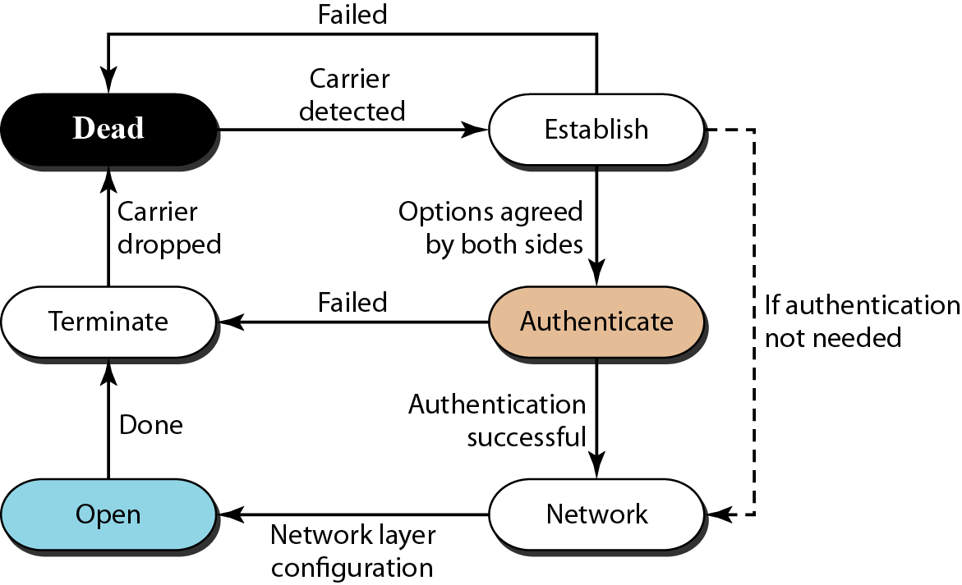
System enters this phase when nodes starts the communication. Options are negotiated between the two parties
Link is not being used. There is no active carrier (at the physical layer) and the line is quiet
Figure 11.33 Transition phases
optional; nodes may decide, during the establishment phase, to skip this phase.
data transfer takes place
negotiation of network layer protocols. Establish network layer agreement before data exchange. Reason: PPP supports multiple protocols at the network layer and sender and receiver must agree on same protocol.

Slide 26
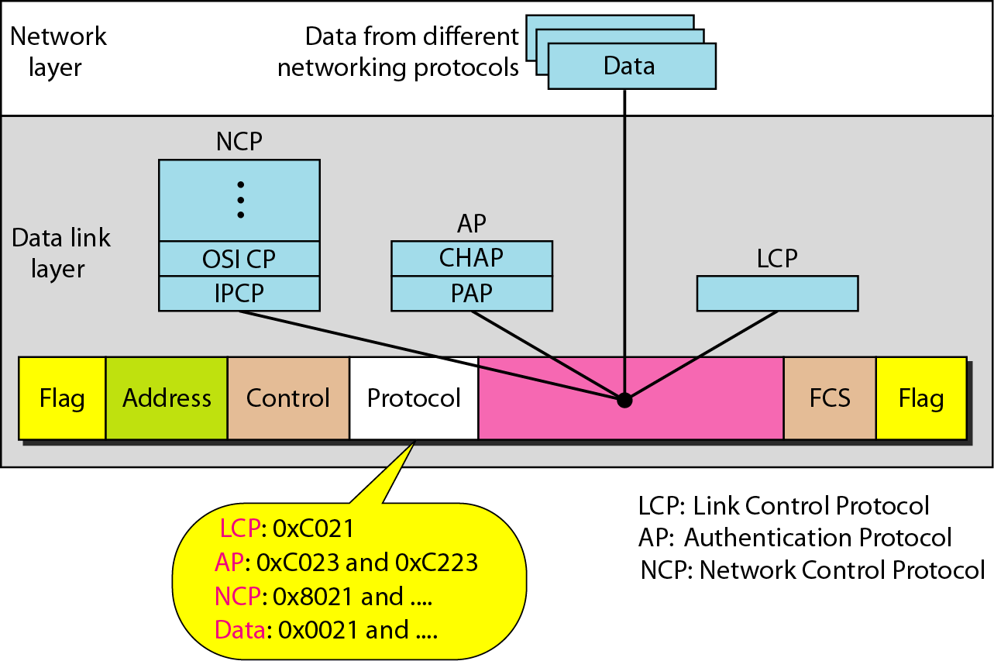
Figure 11.34 Multiplexing in PPP
Establish, maintain, configure, and terminate links. Provides negotiation mechanisms to set options.

Slide 27
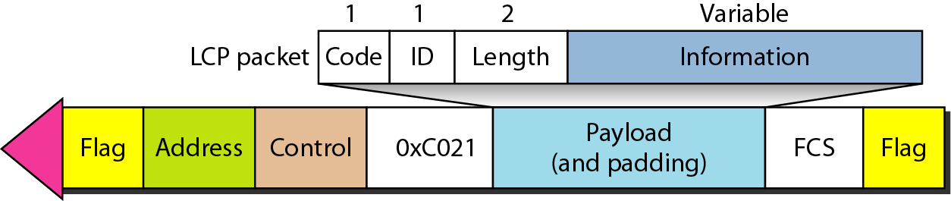
Figure 11.35 LCP packet encapsulated in a frame
options, needed for some LCP packets
holds a value that matches a request with a reply
type of LCP packet
length of the entire LCP packet

Slide 28
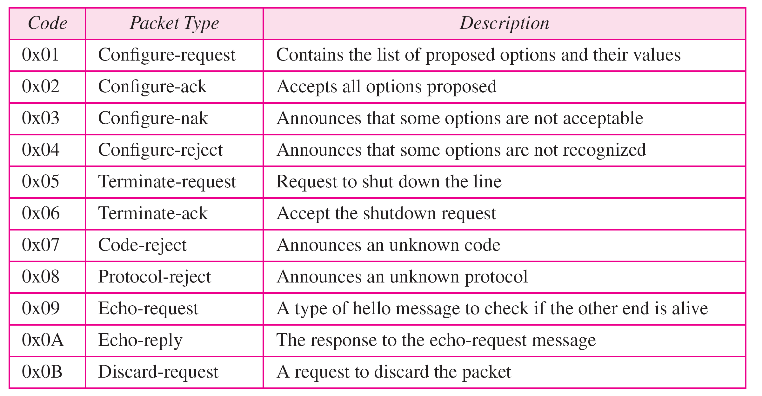
link termination during the termination phase.
link configuration during the establish phase
Table 11.2 LCP packets
link monitoring and debugging

Slide 29
Table 11.3 Common options

Slide 30
Authentication Protocols
PPP is designed for use over dial-up links where verification of user identity is necessary.
Authentication means validating the identity of a user who needs to access a set of resources.
PPP has created two protocols for authentication:
Password Authentication Protocol (PAP) and
Challenge Handshake Authentication Protocol (CHAP).
These protocols are used during the authentication phase.

Slide 31
Password Authentication Protocol (PAP)
The is a simple authentication procedure with a two-step process:
The user who wants to access a system sends an authentication identification(usually the user name) and a password.
The system checks the validity of the identification and password and either accepts or denies connection.

Slide 32
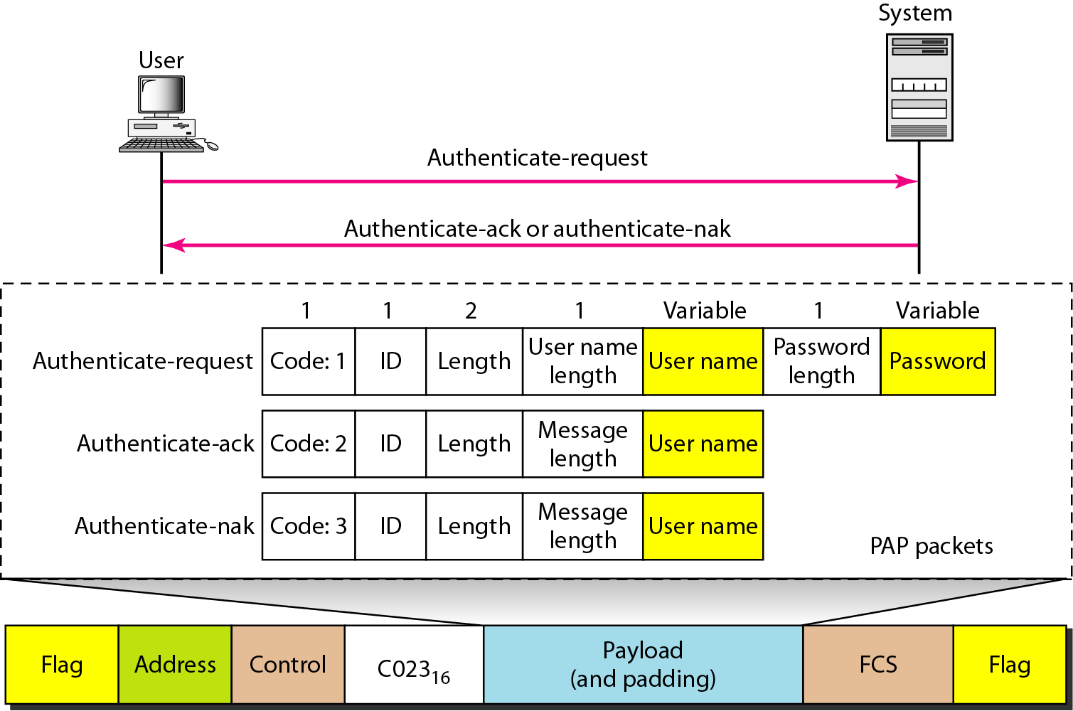
Figure 11.36 PAP packets encapsulated in a PPP frame
used by the user to send the user name and password
used by the system to allow access
used by the system to deny access

Slide 33
Challenge Handshake Authentication Protocol (CHAP)
A three-way hand-shaking authentication protocol that provides greater security than PAP.
Password is kept secret; it is never sent online.
System sends the user a challenge packet containing a challenge value, usually a few bytes.
User applies a predefined function using the challenge value and the user's own password and creates a result.
The user sends the result in the response packet to the system.

Slide 34
Challenge Handshake Authentication Protocol (CHAP)
The system does the same. It applies the same function to the password of the user (known to the system) and the challenge value to create a result.
If the result created is the same as the result sent in the response packet, access is granted; otherwise, it is denied.
CHAP is more secure than PAP, especially if the system continuously changes the challenge value.
Even if the intruder learns the challenge value and the result, the password is still secret.

Slide 35
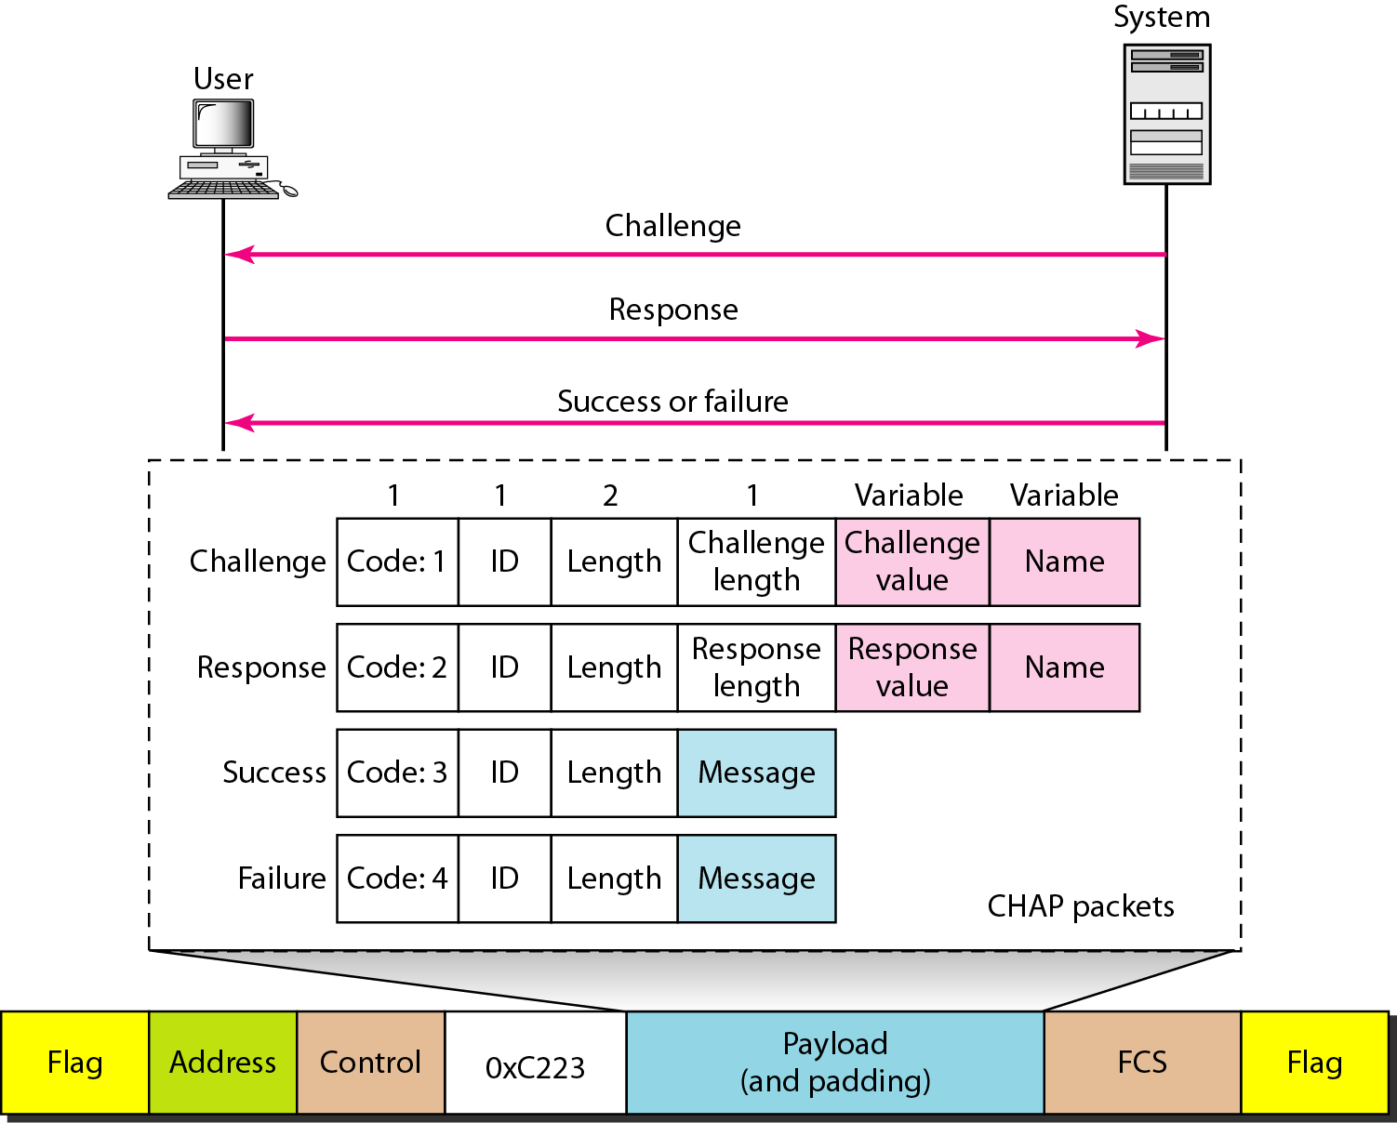
Figure 11.37 CHAP packets encapsulated in a PPP frame
used by the system to send the challenge value
used by the user to return the result
used by the system to allow system access
used by the system to deny system access

Slide 36
Network Control Protocols
PPP is a multiple-network layer protocol.
It can carry a network layer data packet from protocols defined by the Internet, OSI, Xerox, DECnet, AppleTalk, Novel, and so on.
To do this, PPP has defined a specific Network Control Protocol for each network protocol. For example,
IPCP (Internet Protocol Control Protocol) configures the link for carrying IP data packets.
Xerox CP does the same for the Xerox protocol data packets, and so on.
Note that none of the NCP packets carry network layer data
They just configure the link at the network layer for the incoming data.

Slide 37
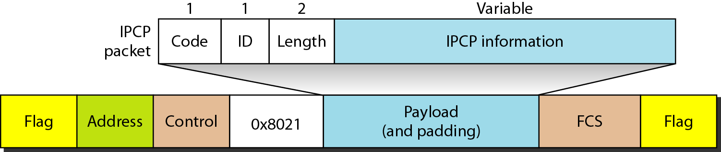
Internet Protocol Control Protocol (IPCP)
configures the link used to carry IP packets in the Internet
Figure 11.38 IPCP packet encapsulated in PPP frame

Slide 38
Table 11.4 Code value for IPCP packets

Slide 39
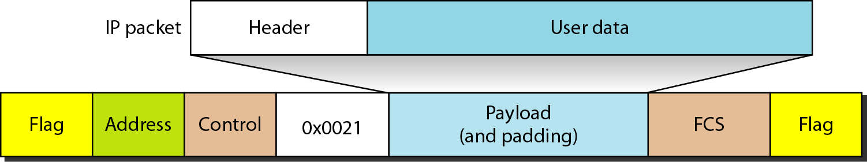
Figure 11.39 IP datagram encapsulated in a PPP frame

Slide 40
Multilink PPP
PPP was originally designed for a single-channel point-to-point physical link.
Availability of multiple channels in a single point-to-point link motivated the development of Multilink PPP.
In this case, a logical PPP frame is divided into several actual PPP frames.
A segment of the logical frame is carried in the payload of an actual PPP frame
To show that the actual PPP frame is carrying a fragment of a logical PPP frame, the protocol field is set to Ox003d.
This new development adds complexity.
For example, a sequence number needs to be added to the actual PPP frame to show a fragment's position in the logical frame.

Slide 41
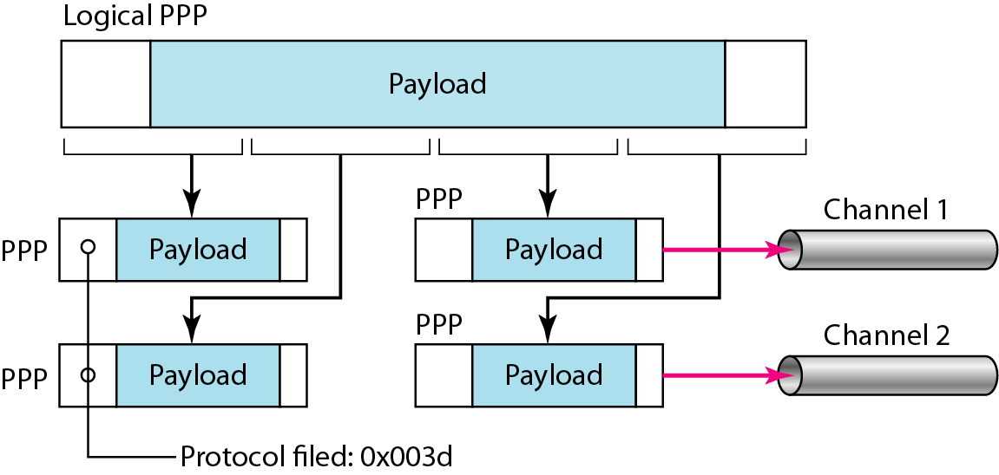
Figure 11.40 Multilink PPP

Slide 42
Example 11.12
Let us go through the phases followed by a network layer packet as it is transmitted through a PPP connection. Figure 11.41 shows the steps. For simplicity, we assume unidirectional movement of data from the user site to the system site (such as sending an e-mail through an ISP).
The first two frames show link establishment. We have chosen two options (not shown in the figure): using PAP for authentication and suppressing the address control fields. Frames 3 and 4 are for authentication. Frames 5 and 6 establish the network layer connection using IPCP.

Slide 43
Example 11.12 (continued)
The next several frames show that some IP packets are encapsulated in the PPP frame. The system (receiver) may have been running several network layer protocols, but it knows that the incoming data must be delivered to the IP protocol because the NCP protocol used before the data transfer was IPCP.
After data transfer, the user then terminates the data link connection, which is acknowledged by the system. Of course the user or the system could have chosen to terminate the network layer IPCP and keep the data link layer running if it wanted to run another NCP protocol.

Slide 44
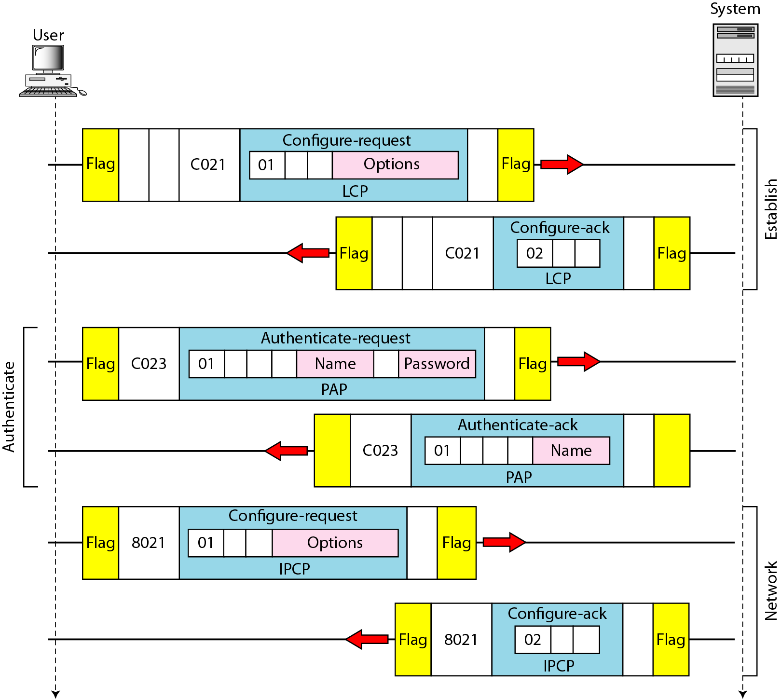
Figure 11.41 An example

Slide 45
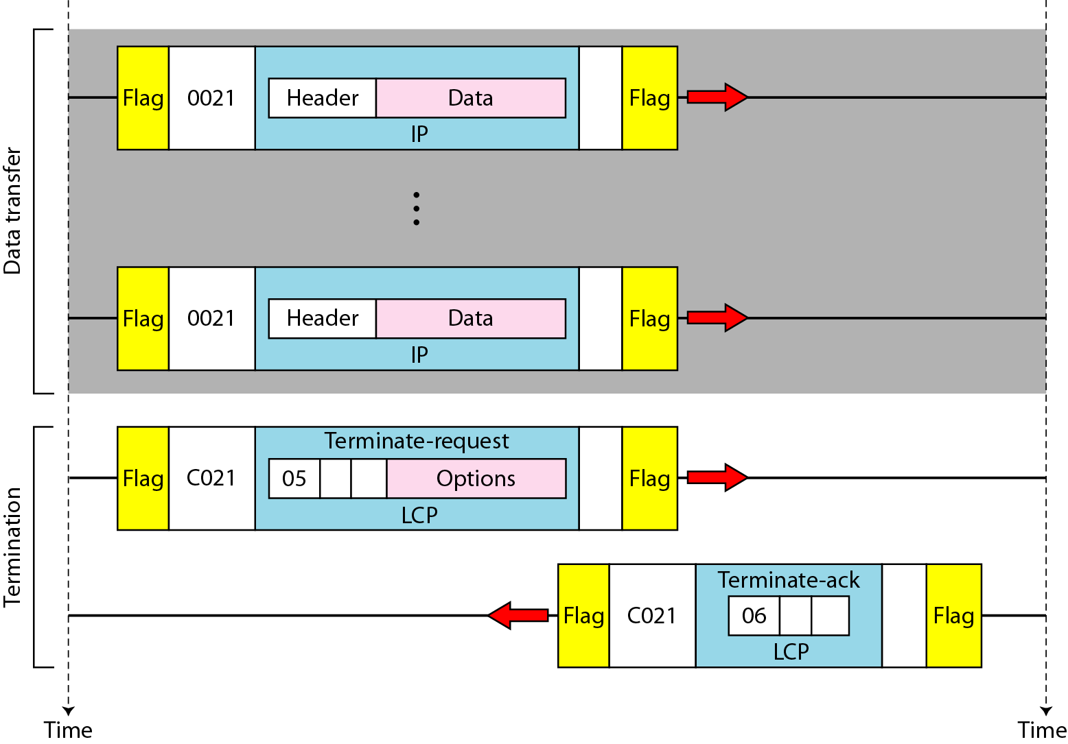
Figure 11.41 An example (continued)

